Slide 1
WDC FULL BOARD MEETING
September 15th, 2022

Slide 2
WELCOME & INTRODUCTIONS
Angela Dunleavy, Board Chair

Slide 3
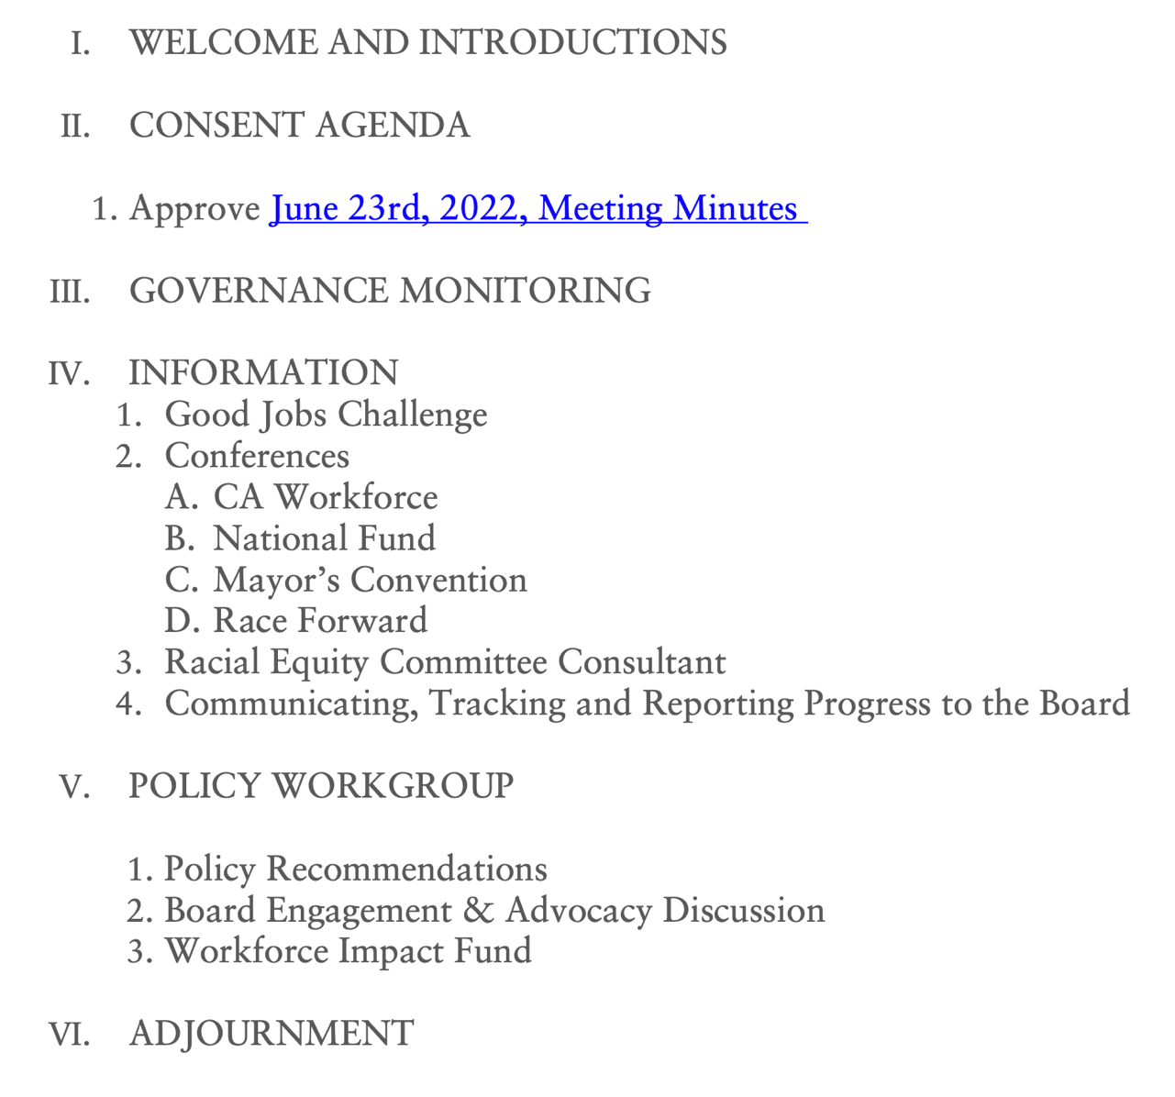
AGENDA
Review draft agenda

Slide 4
PY21 WIOA Monitoring Update
GOVERNANCE

Slide 5
DOL Monitoring Findings: Revisions to Bylaws and Partnership Agreement
Authority to hire, evaluate and terminate the Chief Executive Officer
The partnership agreement (5.C) and bylaws (Article 5.3) for Sea-King WDC give authority to the FAC Committee to hire, evaluate and terminate the Chief Executive Officer of both the LWDB as well as the fiscal agent (WDC).
WIOA requires that these fall under the full LWDB’s authority. It is allowable for a LWDB to rely upon a subcommittee of the board to carry out certain functions on behalf of the full Board as long as the final action goes to the full LWDB Board for approval. Note: The WDC’s current practice requiring all actions of the WDC are taken to the LWDB for final approval complies with the law.
Action Required: Amend the partnership agreement and bylaws to either reflect that practice or clarify that actions that are LWDB actions (i.e. regarding the hiring and termination of the CEO, as well as others) are taken to the full LWDB for action.
Authority to approve or deny one stop certification and a contract
Language in the partnership agreement (3.B) gives the CLEOs the authority to approve or disapprove contracts for service providers (other than contracts to the city or county) and allows them to approve or disapprove the certification or recertification of one stops conflict with federal law that provides this authority to the LWDC.
Action Required: Revise the partnership agreement to ensure it does not assert authority to the chief elected officials that under federal law belong to the LWDB.

Slide 6
Governance Structure (June 2021)
CHIEF LOCAL ELECTED OFFICIALS
Designate fiscal agent,
administer federal money & appoint LWDB board
LOCAL WORKFORCE DEVELOPMENT BOARD
Leads Regional System,
Develops & Oversees Strategy & Priorities
Recommendations:
Strengthen & expand the LWDB’s role as regional policy body
Separate fiscal agent oversight for operational and compliance issues related to the role of the fiscal agent.
Establish new LWDB Committees to support transformation priorities
FINANCE & ADMINISTRATION COMMITTEE
Governs WDC, Makes Funding Recommendations, Oversees Fiscal & Operational Affairs
WORKFORCE DEVELOPMENT COUNCIL
Staffs Boards, Committees & Implements Decisions
INDUSTRY ENGAGEMENT COMMITTEE
RACIAL EQUITY COMMITTEE
POLICY
COMMITTEE
ADDT’L
COMMITTEES

Slide 7
GOVERNANCE JOURNEY
Deadline
Revisions to Bylaws and Partnership Agreement
State ESD Monitor Findings: Bylaws and Designation Agreement
April 2020
DOL Monitor Governance Findings
Dec 2020
Bylaws 2.0
Partnership Agreement
Executed
2019
JULY
2020
APRIL
JUNE
SEPT
DEC
2021
JUNE
2022
JULY
DEC
Governance Workgroup (09/2020 – 6/2021)
LWDB Leadership, CEO, CLEO Reps
SAC Full Board
March 12, 2021 March 25, 2021
May 7, 2021 May 20, 2021
June 4, 2021 June 17, 2021
State ESD Monitor & DOL
Modifications needed to Bylaws and Partnership Agreement
New By Laws Establishing Regional Transformation
Approved
Designation Agreement
Executed

Slide 8
INFORMATION

Slide 9
GOOD JOBS CHALLENGE

Slide 10
CONFERENCES

Slide 11
MEETING OF THE MINDS
CWA Presentation | September 7,2022 |Marisol Tapia Hopper

Slide 12
IMMIGRANT & REFUGEE STRATEGIES
SYSTEM COORDINATION
LANGUAGE ACCESS & ADVOCACY
ACCESS TO WORK-BASED LEARNING
DIGITAL EQUITY
Workgroup formed with the WA State Refugee Coordinator’s Office.
Immigrant & Refugee Summit
Connect high-skilled immigrants, and foreign-educated professionals to long-term careers
Need: to incorporate digital equity goals in workforce development
Digital Navigators at WorkSource locations
Digital Equity Asset Map
Digital Needs Assessment Tool
WBL partnerships in opportunity sectors
Operator Contract - translation and Interpretation costs
Afghan Arrivals Coordination Meetings
Electronic Job Seeker Referral Form
Workgroup formed Emergency translation for UI insurance
Need: equitable language access services
Need: invest in, and scale up subsidized employment programs
Need: build stronger partnerships with workforce system partners
Braided funding: WIOA & Non-WIOA

Slide 13
SERVING ORR POPULATIONS IMPACTED BY THE DIGITAL DIVIDE
(Office of Refugee Resettlement)
DIGITAL EQUITY ASSET MAP
Support AJC staff, community partners and job seekers locate digital resources
Create a standard process and coordination to assess the digital needs of job seekers
DIGITAL NAVIGATORS AT AJCS
Partnership with Washington Service Corps, Washington State Library & ESD
DIGITAL NEEDS ASSESSMENT TOOL
DIGITAL EQUITY SURVEY
Understand the digital needs in our region
Advocate and advance digital inclusion efforts in our region
Identify service gaps and lack of investments
Ongoing analysis of assessment results
Target funding to support access to devices, the internet, and digital skills training
Help develop digital equity recommendations
Inform policymakers about needed workforce investments
AmeriCorps Digital Navigators at AJCs provide digital skills training and one-on-one support to customers

Slide 14
CONFERENCES

Slide 15
RACIAL EQUITY COMMITTEE CONSULTANT

Slide 16
COMMUNICATING, TRACKING & REPORTING PROGRESS TO THE BOARD

Slide 17
POLICY RECOMMENDATIONS 2022-2023
In alignment with our North Stars to center Job Quality, Racial Equity, and System Change…
1
Secure financial support for the WDC as regional backbone for workforce development to act as coordinator of policy/priority alignment among regional institutions and partners, with built data capacity to measure progress on equity goals.
2
In close collaboration with community-based partners, pursue specific strategies to connect young BIPOC workers to high quality jobs. Key strategies include apprenticeships and onramp training, and digital literacy. Important near-term funding opportunity: Federal Infrastructure Act.
3
Align WDC goals with County/City/Port workforce priorities, consistently advocate for labor management partnerships.

Slide 18
POLICY ACTION PLAN 2022-2023
Priorities:
High Road/Infrastructure Jobs access for BIPOC.
Funding for WDC as regional backbone; including Research & Development.
Investments in labor/management partnerships linking training to wrap around supports for students**
WIOA Reauthorization
Guiding principles:
Collectively advance WDC policy priorities through legislative and administrative advocacy
Align policy advocacy with Regional Strategic Plan strategies
Center racial equity, job quality, and system change
Sept 22
King County Exec proposes annual budget
Sept 26
Seattle Mayor proposes annual budget
Sept 27
Port Commission Briefing
Oct 4- Nov 13
King County Council budget deliberations
Sept 28- Nov 18
Seattle City Council budget deliberations
Oct 20- Nov 8
Draft budget released to public & 11/8 public hearing
Nov 15
King County Council adopts budget
Nov 21
Seattle City Council adopts budget
Nov 15
Port Commission adopts budget
June 2
July 12
Sept 15
Dec 8
Policy Workgroup (PW) meeting
(PW) meeting
Full Board meeting
Full Board Meeting
March 10
June 2-July12
June 12-Aug 26
3 Months
January 9
PW members identify 3 policy priorities
PW finalize recommendations for full Board
Board/staff outreach to legislators (status updates sent to PW)
2022 State legislative session ended
Digital Equity (HB 1723)*
State Registered Apprenticeship Programs (SB 5600)*
2023 State legislative session begins
Board outreach to sectoral partners for joint advocacy/collaboration
*Workforce priorities passed by the legislature during 2022 session.
Staff track progress toward 2023 session
**Priorities not passed by the legislature, requiring more advocacy.

Slide 19
CLIENT SPOTLIGHT
Video interview - Afzal

Slide 20
WORKFORCE IMPACT FUND
State Workforce Development Investment Fund

Slide 21
Workforce Impact Fund Request: 2023 Budget
Proposed new state workforce development investment
Leverage Local Workforce Development Board’s infrastructure and funding
Predictable, flexible and consistent funding tFlexible funds
Support local regional priorities
Status: Size and structure Final Decision Package being negotiated with Workforce Training Board

Slide 22
ADJOURNMENT
Thank you
The next Full Board Meeting is scheduled on December 8th, 2022.

