Slide 1

WDC FINANCE & ADMINISTRATION COMMITTEE
November 4th, 2022

Slide 2
WELCOME & INTRODUCTIONS
Angela Dunleavy, Board Chair

Slide 3

AGENDA
Review draft agenda

Slide 4

CEO UPDATE
Strategic Framework
Governance: LWDB

Slide 5
Primary objective: develop an approach to systematically track and communicate work progress to the board of directors
NICOLE TRIMBLE
      Key Steps
Develop strategic framework that clearly reflects WDC mission and role in the Regional Plan and organizational priorities for the next three years.
Definitions of strategic pillars (racial equity, job quality, system change)
Identify what ‘success’ looks like for each strategic pillar and how success will be measured
Check/adjust w/ Jiquanda and Angela + Staff leadership
Dashboard draft design
Dashboard goes live
Oct – Dec
2022
Jan – Feb
2023
March
2023

Slide 6
GOVERNANCE: LWDB
Board Membership
Board Officer Elections

Slide 7
BOARD MEMBERSHIP UPDATES
Departing Members
  Princess Ayers- Stewart - Business
  Justin Magouirk Crowe - Business
  Berit Eriksson – Workforce Representative/Labor
  John Bowers - Required Partner (Adult Basic Education)
Upcoming/Current Vacancies (6)
    3 Business
    1 Labor/Workforce Representative
    2 Required Partners:
      1 Adult/Basic Education
      1 Economic Development (Replacing Brian McGowen, Greater Seattle Partners)

Slide 8
BOARD COMPOSITION CRITERIA
WIOA Required Criteria 20 CFR 679.320(b)
Business: (51%)A majority of the members must be representatives of business in the local area. (1) Be an owner, chief executive officer, chief operating officer, or other individual with optimum policy-making or hiring authority; and (2) Provide employment opportunities in in-demand industry sectors or occupations.
Workforce Representative (20%) Must include at least two members from labor organizations, one or more joint labor-management, or union affiliated, registered apprenticeship program within the area who must be a training director or a member of a labor organization.
Required Partners: (1) Eligible training provider administering WIOA Title II adult education and literacy ; (2) institution of higher education, including community colleges; (3) economic and community development entities; (4) State Employment Service office under the Wagner-Peyser Act and (5) the programs carried out under title I of the Rehabilitation Act of 1973, other than sec. 112 or part C.

Slide 9
BOARD OFFICER NOMINATIONS
Nominating Committee:
  Must be formed to determine elections process
  CLEO representatives and board members not running for office.
  A list of all individuals nominated for officer roles and willing to compete sent to the board 30 days in advance of elections
  The LWDB/WDC Chair shall be elected by the LWDB from among the business representative members, as required by 20 CFR 679.330.
  The term of all offices two (2) years beginning on the first day of July and shall end on the last day of June.
  REQUIRED OFFICERS LWDB
    Chair (must be a Business Member)
    Vice Chair
  Optional:
    Secretary
    Treasurer
    Secretary/Treasurer

Slide 10

ACTION ITEMS
Approve FAC Minutes September 9th, 2022
Full Board Consent Agenda
  Bylaws & Partnership Agreement Modification

Slide 11
GOVERNANCE
Revisions to Bylaws and Partnership Agreement

Slide 12
WIOA: GOVERNANCE STRUCTURE INTENT AND REQUIREMENTS
Intent
Streamline and improve the effectiveness of public workforce investment system the governing structures
Empower elected officials and workforce boards to collaborate regionally
Engage key stakeholders needed to lead the system and achieve workforce and economic development goals.
Roles, Authority and Responsibilities articulated in WIOA
Chief Local Elected Officials: KC Executive and the Mayor have agreed to act jointly actions to be taken as CLEOS
Local Workforce Development Boards
Local Fiscal Agent

Slide 13
REVISIONS TO BYLAWS AND PARTNERSHIP AGREEMENT
ACTION REQUESTED: Approval of amended governance documents
Bylaws
Partnership Agreement
LWDB Bylaws: Defines Board structure, operations, and oversight and authority over the implementation of WIOA policies, programs, and operations.
Revisions:
Clarified LWDB’s authority: hiring CEO, final approval of policies and budget
Partnership/Designation Agreement: CLEOS roles, responsibilities and authority – fiscal and administrative oversight; designates WDC as fiscal agent and responsibilities; CLEOS – LWDB respective and shared responsibilities and authority
Revisions:
Clarified LWDB and CLEOS shared decision-making authority and partnership.
Streamlined - Deleted sections in Bylaws
  Additional Revisions related to CLEOS’s liability pending City-County Legal counsel.

Slide 14

GOVERNANCE JOURNEY
Deadline
Revisions to Bylaws and Partnership Agreement
State and DOL Monitoring Findings:
Governance
April 2020
Dec 2020
Bylaws 2.0 &
Partnership Agreement
Executed June 2021
July 2022
State ESD Monitor & DOL
Bylaws and Partnership Agreement
8/9 FAC: DOL/ESD Presentation
2019
2020
JULY
APRIL
SEPT
JUNE
JULY
AUG
OCT
NOV
DEC
2020
2021
2022
Governance Workgroup
(09/2020 – 6/2021)
LWDB Leadership, CEO, CLEO Reps
SAC Full Board
3/12/21 3/25/21
5/7/21 5/20/21
6/04/21 6/17/21
New By Laws Establishing Regional Transformation
Approved
10/11: Draft revisions sent to DOL/ESD; LWDB Chair, CLEOS
10/24: Meeting with DOL/ESD re comments
10/26: Revised document sent to CLEOs for legal review/approval
NEXT STEPS:
11/4: FAC
12/8: LWDB
CLEO Legal Review (pending)
12/31: Deadline

Slide 15
REPORT OUT
WorkSource Seattle-King County System
Grants Update

Slide 16
Notes:
WDC’s responsibilities re WorkSource SKC:
Certify that WorkSource system meets high quality standards for operations and customer service
Contract for WorkSource Operator to assist with system integration, outreach and staff training
Contract for WIOA Title 1 services delivered through WorkSource
Develop policy to communicate expectations for WorkSource to meet regional needs
Negotiate Memoradum of Understanding MOU and Infrastructure Funding Agreement (IFA)
Menu of Services What WorkSource offers to job seekers and employers Free services to all
Job Seekers Job Search assistance like resume review, interview prep
Career Planning and Training coaching, Labor Market Information, career exploration
Technology computers, internet, copiers, printers
Events career fairs, employer panels and hiring events
Resources referrals to partners that can provide housing, food
Employers Recruitment assistance to create quality jobs, job posting, hiring events, connections to Work Based Learning, Retention Worker Retraining program – connections to shared work rather than layoff
Reduction Rapid Response to layoffs, WARN and Trade Act support

Slide 17
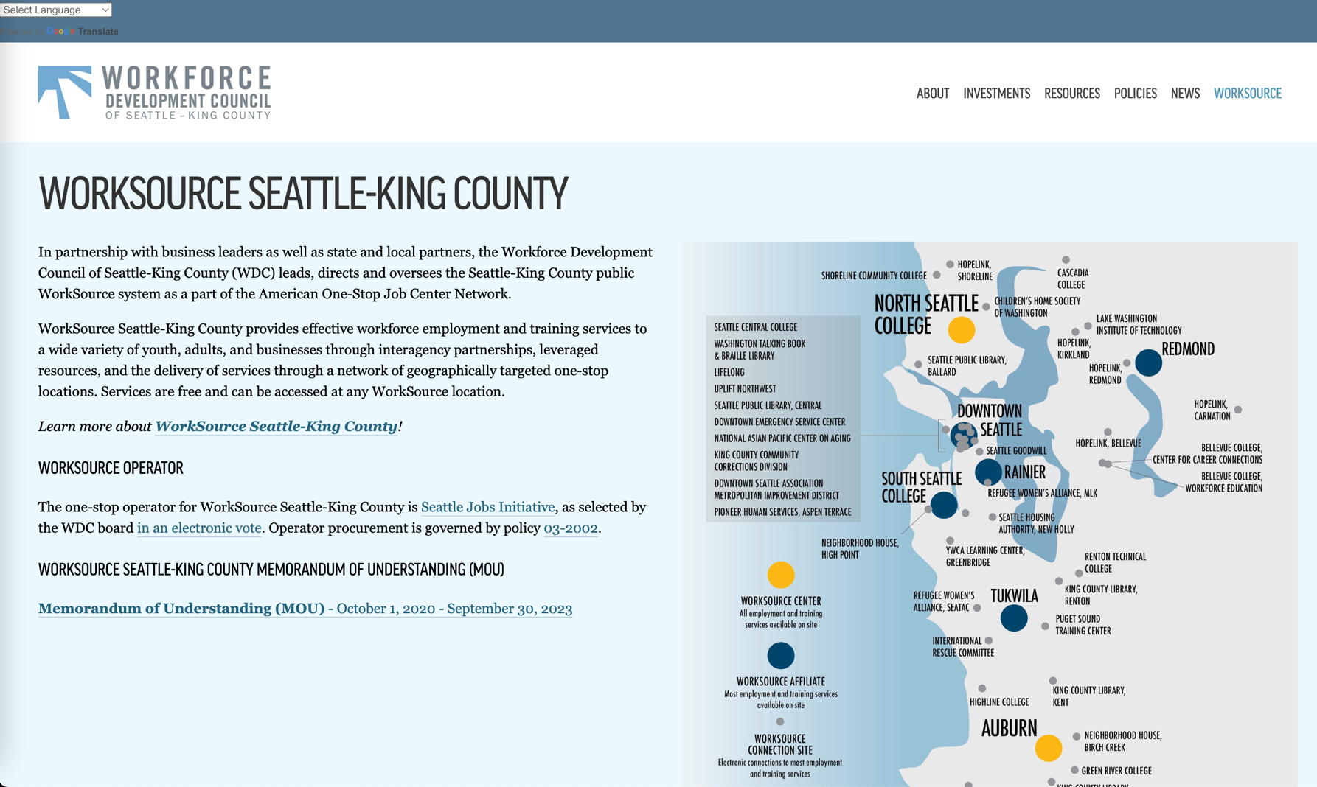
Notes:
WDC’s responsibilities re WorkSource SKC:
Certify that WorkSource system meets high quality standards for operations and customer service
Contract for WorkSource Operator to assist with system integration, outreach and staff training
Contract for WIOA Title 1 services delivered through WorkSource
Develop policy to communicate expectations for WorkSource to meet regional needs
Negotiate Memoradum of Understanding MOU and Infrastructure Funding Agreement (IFA)
Menu of Services What WorkSource offers to job seekers and employers Free services to all
Job Seekers Job Search assistance like resume review, interview prep
Career Planning and Training coaching, Labor Market Information, career exploration
Technology computers, internet, copiers, printers
Events career fairs, employer panels and hiring events
Resources referrals to partners that can provide housing, food
Employers Recruitment assistance to create quality jobs, job posting, hiring events, connections to Work Based Learning, Retention Worker Retraining program – connections to shared work rather than layoff
Reduction Rapid Response to layoffs, WARN and Trade Act support

Slide 18
WS-SKC MEMORANDUM OF UNDERSTANDING (MOU)
The Workforce Innovation and Opportunity Act (WIOA) states that each required partner shall enter into a MOU with the local workforce development board and CLEOs outlining:
a description of services provided by partners within the One-Stop delivery system,
how the operating costs of the system will be funded (the IFA)
a method for referrals
strategies for serving those with barriers to employment
duration – must be renewed every three years
The MOU reinforces the shared mission for the system and partner commitment to work together.
The MOU is entered into in the spirit of cooperation and collaboration by the Workforce Development Council of Seattle-King County, the One-Stop Operator, the Chief Local Elected Officials and all system partners.
Notes:
WorkSource SKC MOU

Slide 19
INFRASTRUCTURE FUNDING AGREEMENTS (IFA)
Intent of WIOA with IFA
WIOA makes improvements to the public workforce system including a requirement that partners dedicate funding for allowable infrastructure and additional costs that are allocable to the partner and in proportion to the partner’s use and the relative benefit received by the partner program.
Infrastructure costs are non-personnel costs necessary for the general operation of the One-Stop Center.
Other Costs include Applicable Career Services to include the costs of the provision of career services described in section 134(c)(2), as applicable to each program. Other Costs determined via negotiations with the WorkSource partners.

Slide 20
INFRASTRUCTURE FUNDING AGREEMENTS (IFA)
The Local Funding Mechanism
  In the local funding mechanism, the Local WDB, chief elected officials, and one-stop partners agree to amounts and methods of calculating amounts each partner will contribute for one-stop infrastructure funding, include the infrastructure funding terms in the MOU, and sign the MOU.
  The WDC and its partners utilize FTE’s, Square footage and annual customer counts to determine the proportionate share of each partner’s contribution.

Slide 21
INFRASTRUCTURE FUNDING AGREEMENTS (IFA)
What is the role of the WDC of Seattle King County?
The Workforce Development Council as the WIOA state board is directed with developing policies relating to the roles and contributions of the entities carrying out the one-stop partner programs and provide approaches to facilitating equitable and efficient cost allocation in such system.

Slide 22
INFRASTRUCTURE FUNDING AGREEMENTS (IFA)
The IFA shows the One-Stop Partners that are the entities that carry out the participating programs in a Local Area. There are two types of IFA Partners:
  Required Partners are one-stop partners required by WIOA to participate in one-stop centers.
  Additional Partners are all one-stop partners that are not required to participate in one-stop centers.

Slide 23
INFRASTRUCTURE FUNDING AGREEMENTS (IFA)
Required Partners at One Stops (Auburn and North Seattle College)
WIOA Title I (WDC)
WIOA Title II (Adult Literacy - Colleges)
WIOA Title III, TAA, Vets, UI, MSFW (ESD)
WorkFirst (ESD)
WIOA Title IV (DVR)
WIOA Title IV (DSB)
WIOA Title V SCSEP (NAPCA)
WIOA Title V SCSEP (AARP Foundation)
Carl Perkins (Workforce Education - Colleges) HUD Employment and Training
YouthBuild
Job Corps
Native American Programs (not required)
CSBG (Not available in region)
Second Chance Programs (Data not available)

Slide 24
INFRASTRUCTURE FUNDING AGREEMENTS (IFA)
What is the basis of IFA Cost Sharing?
All partner contributions to the costs of operating and providing services within the one-stop center system must:
be proportionate to the relative benefits received,
adhere to the partner program’s federal authorizing statute, and
adhere to the Federal cost principles requiring that costs are reasonable, necessary and allocable.

Slide 25
INFRASTRUCTURE FUNDING AGREEMENTS (IFA)
WorkSource Seattle-King County PY22 Operating Budget (Oct 1, 2022 - Sept 30, 2023)
 | Infrastructure | Career Services | Other | Totals
Centers (AJC) |  |  |  | 7,842,817
Auburn | 364,275 | 3,228,500 | - | 3,592,775
North Seattle | 376,242 | 3,873,800 | - | 4,250,042

Slide 26
INFRASTRUCTURE FUNDING AGREEMENTS (IFA)
WorkSource Seattle-King County PY22 Operating Budget (Oct 1, 2022 to Sept 30, 2023)
 | Infrastructure | Career Services | Other | Totals
Affiliates |  |  |  | 11,418,990.00
Downtown | 148,030.00 | 570,000.00 | 101,626.00 | 819,656.00
Rainier | 555,020.00 | 2,133,750.00 | - | 2,688,770.00
Redmond | 476,503.00 | 2,239,500.00 | - | 2,716,003.00
South Seattle | 65,243.00 | 350,000.00 | 50,568.00 | 465,811.00
Tukwila | 395,000.00 | 4,133,750.00 | 200,000.00 | 4,728,750.00

Slide 27
INFRASTRUCTURE FUNDING AGREEMENTS (IFA)
WorkSource Seattle-King County PY22 Operating Budget (Oct 1, 2022 to Sept 30, 2023)
Connection Sites | Infrastructure | Career Services | Other | 363,958.00
Bellevue College | 17,550.00 | 3,770.00 | - | 21,320.00
Cascadia College | 1,440.00 | 1,813.50 | 255.00 | 3,508.50
Highline College | 765.00 | 6,026.75 | - | 6,791.75
Green River College | 64.25 | 12,382.75 | - | 12,447.00
Lake WA Institute of Technology | 843.75 | 5,872.25 | 443.75 | 7,159.75
Renton Technical College | 18,212.50 | 1,357.75 | 3,797.50 | 23,367.75
Seattle Central College | 894.00 | 4,590.50 | - | 5,484.50
Shoreline College | 2,801.00 | 10,269.50 | 125.00 | 13,195.50
South Seattle College Georgetown | 10,983.75 | 3,495.75 | - | 14,479.50
Children's Home Society of WA | 554.25 | 41.50 | 549.50 | 1,145.25
Downtown Emergency Service Center | 1,700.00 | 856.00 | - | 2,556.00
Hopelink (Bellevue, Carnation, Kirkland, Redmond, Shoreline) | 3,468.75 | 5,980.00 | 2,220.50 | 11,669.25
IKRON | 489.00 | 141.25 | - | 630.25
King County Community Corrections Div. | 125.00 | 21,250.00 | - | 21,375.00
King County Library (5 Sites) | 4,199.50 | 18,939.75 | - | 23,139.25
Lifelong | 2,456.25 | 17,033.75 | 626.75 | 20,116.75
Millionair Club Charity | 8,700.00 | 2,812.50 | 218.75 | 11,731.25
Multi-Service Center | 3,649.75 | - | 327.00 | 3,976.75
Neighborhood House - Birch Creek | 731.50 | 5,577.25 | - | 6,308.75
Neighborhood House - HighPoint | 1,574.00 | 3,849.50 | - | 5,423.50
Neighborhood House - Kent | 1,582.00 | 12,631.00 | - | 14,213.00
Puget Sound Training Center | 14,362.25 | 8,946.75 | - | 23,309.00
Refugee Women's Alliance-ReWA (MLK, SeaTac) | 1,192.00 | 17,921.00 | 2,734.00 | 21,847.00
Seattle Goodwill | 15,023.75 | 10,397.50 | - | 25,421.25
Seattle Housing Authority - New Holly | 737.50 | 3,087.50 | 250.00 | 4,075.00
Seattle Public Library (Ballard) | 734.88 | 7,487.75 | - | 8,222.63
Seattle Public Library (Central) | 1,900.50 | 14,975.50 | - | 16,876.00
Washington Talking Books and Braille | 730.75 | 468.00 | - | 1,198.75
YWCA Learning Center - Greenbridge | - | 22,679.13 | 10,290.00 | 32,969.13

Slide 28
Infrastructure Funding Agreements (IFA)
Center | Budget | FTE | Annual Cost Per Seat
Auburn | 218,926.00 | 32.285 | 6,781.04
North Seattle College | 280,079.00 | 19 | 14,741.00
Rainier | 555,020.00 | 21.3375 | 26,011.48
Redmond | 476,503.00 | 22.395 | 21,277.20
South Seattle College | 50,568.00 | 3.5 | 14,448.00
Tukwila | 595,000.00 | 41.3375 | 14,393.71
YWCA | 249,756.00 | 5.7 | 43,816.84
Total | 2,425,852.00 | 145.555 | 16,666.22

Slide 29
GRANT UPDATE
Marie Kurose, WDC CEO

Slide 30
GRANTS FUNDING UPDATE
Bill and Melinda Gates Foundation | General Operating Support | $300,000 ($100k/year) | 10/2022 – 9/2025 (3 years )
State Dept of Commerce | Digital Navigator | $988,505 | 10/2022 – 6/2023
Department of Labor National | QUEST Quality Jobs Equity Strategy and Training | $3,189,231 | 11/2022- 9/2024

Slide 31

DIGITAL NAVIGATOR GRANT
Marisol Tapia Hopper, WDC Project Manager

Slide 32
ADVANCING DIGITAL EQUITY IN WORKFORCE DEVELOPMENT
Digital Equity Asset Map
Support AJC staff, community partners and job seekers locate digital resources
Create a standard process and coordination to assess the digital needs of job seekers
Digital Navigator Services
Provide regionally coordinated digital navigation services.
Digital Needs Assessment Tool
Digital Equity Survey
Understand the digital needs in our region
Advocate and advance digital inclusion efforts in our region
Identify service gaps and lack of investments
Ongoing analysis of assessment results
Target funding to support access to devices, the internet, and digital skills training
Help develop digital equity recommendations
Inform policymakers about needed workforce investments
AmeriCorps Digital Navigators at AJCs provide digital skills training and one-on-one support to customers
Partnership with Washington Service Corps, Washington State Library & ESD

Slide 33
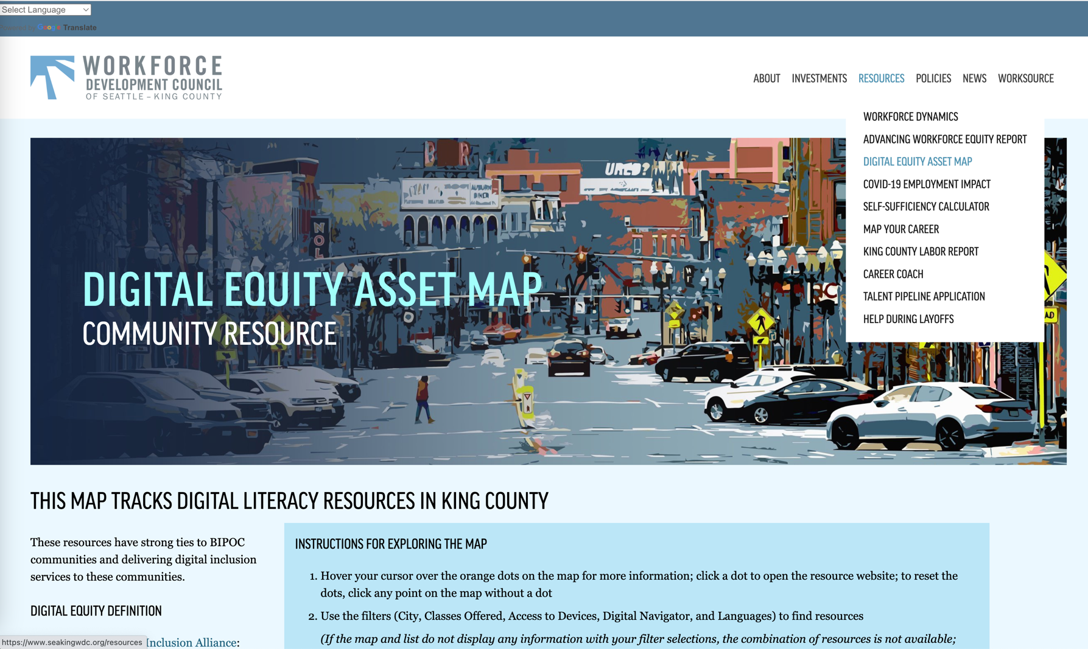

Slide 34
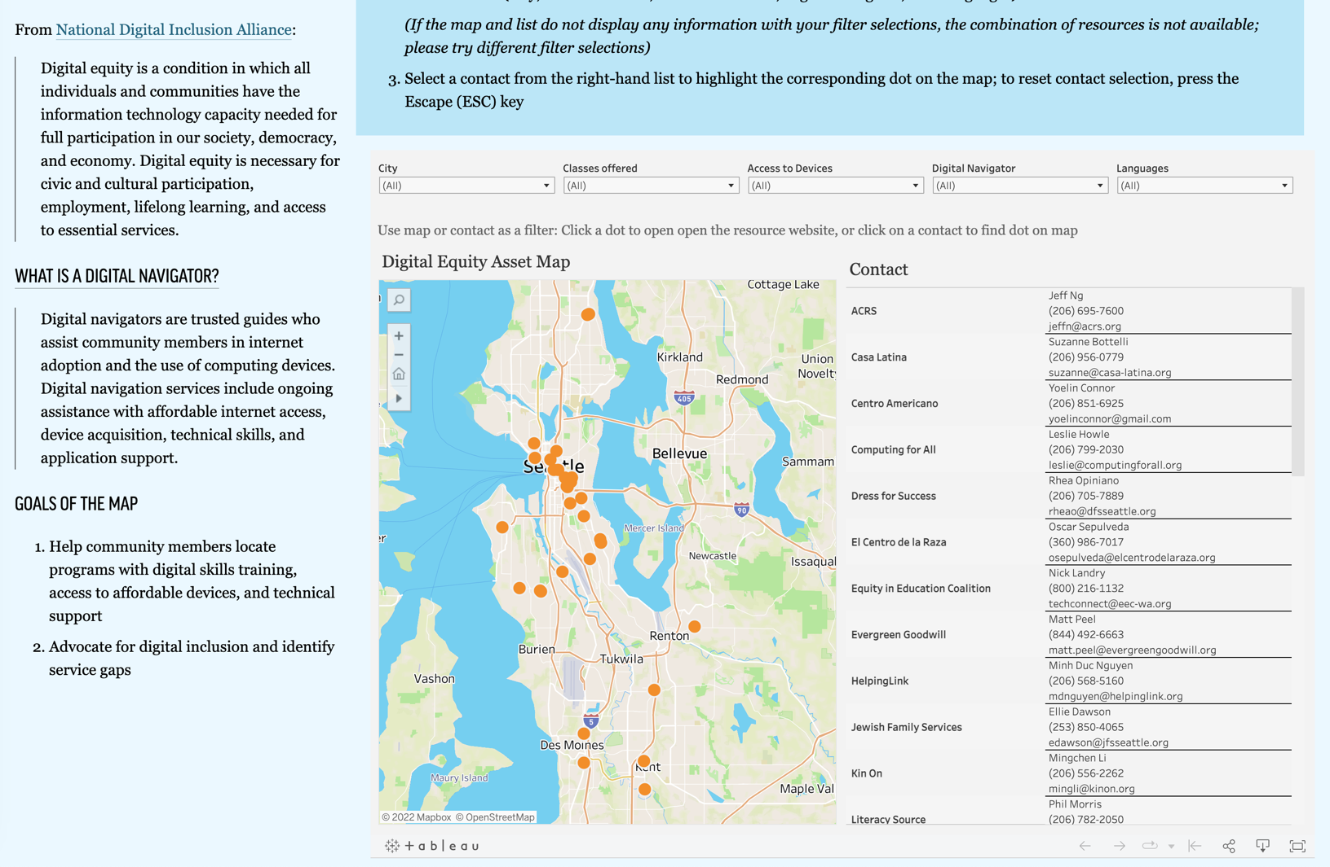

Slide 35
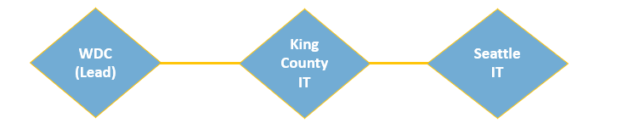
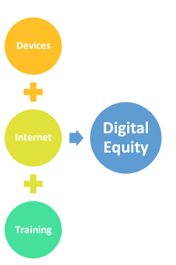
WA STATE DEPT. OF COMMERCE’S DIGITAL NAVIGATOR GRANT
Background
Our consortium was awarded funding to provide regionally coordinated digital navigation services to residents in Seattle-King County.
This funding seeks to address funding inequities that create barriers for non-profit organizations to access government funding, many of which are smaller community-based nonprofit organizations.
Purpose
Amplify access to affordable internet, devices, digital skills training and digital navigator services through a cohort-supported funding model.
Grant Award: $988, 505
Period: October 1, 2022 – June 30, 2023.
Serve: 3,750 community members

Slide 36
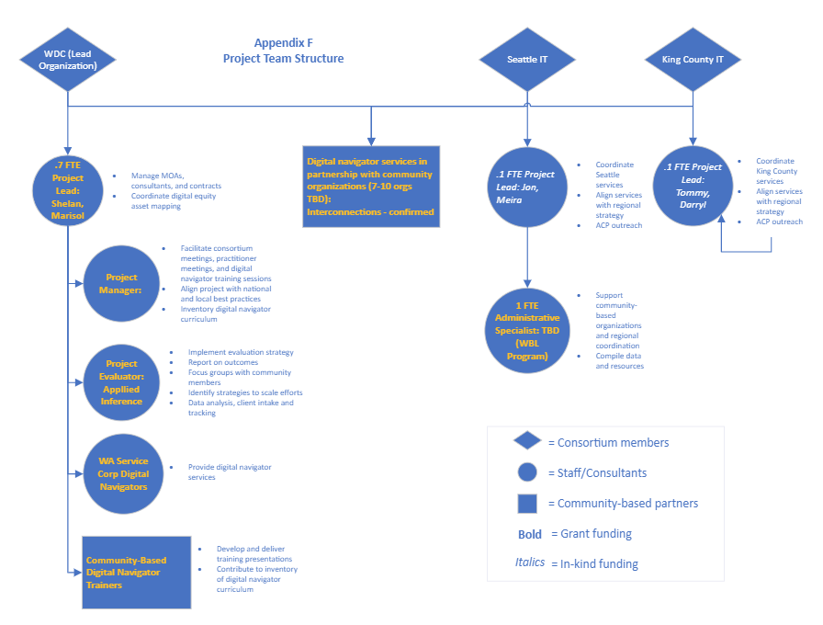

Slide 37
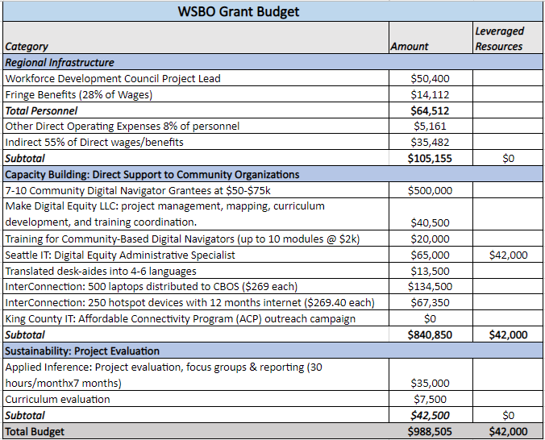
WA STATE DEPT. OF COMMERCE’S DIGITAL NAVIGATOR GRANT

Slide 38
DIGITAL NAVIGATOR GRANT - FOUR CORE ELEMENTS
Digital Navigator Services
Digital Skills Training
Affordable Connectivity Program Outreach
Device Distribution Hotspots & Laptops
4 Core Elements
Ongoing assistance with internet access, device acquisition, technical skills and application support.
Digital Navigator Cohort
Digital Navigation
Digital Skills Training
ACP Outreach
Device Distribution
The process to teach essential computer skills and the use of technology in daily life.
Assist community members learn and apply for the Affordable Connectivity Program.
Assist community members access laptops and hotspots in partnership with InterConnection.

Slide 39
DIGITAL NAVIGATOR GRANT TIMELINE
We are almost here
Community Informational Session
Answers to Q&A
Announce Successful Proposals
Release
RFQ
Q&A
Period
Proposals
Due
Begin Work
10/12
10/12- 10/19
10/17 & 26
10/20
10/30
11/10
12/1

Slide 40

QUALITY JOBS, EQUITY, STRATEGY, AND TRAINING (QUEST)
DISASTER RECOVERY NATIONAL DISLOCATED WORKER GRANTS (DWGS)
Partnership Development
Strategic partnerships with community-based organizations
Community Outreach
Leveraging trusted community groups to outreach to targeted populations
Business
Engagement
Infrastructure-related sectors
Career and Training Services
Served: 213
Training: 20
Work-based Learning: 30
Exits to Employment: 138
Care Economy
Environmental remediation
Other critical industries: Transportation and Warehousing, Information Technology, Leisure/ Hospitality
Building on success of Disaster Relief and Employment Recovery DWGs.
Strengthen partnerships to understand, respond, and serve community.
Strengthen partnerships within the WorkSource system
PERIOD OF PERFORMANCE: NOVEMBER 1, 2022 – SEPTEMBER 30, 2024
BUDGET: $3,189,231
Notes:
CHALLENGE -
When you look at our region’s economic indicators – you see two pictures:
Of the country’s 100 largest metropolitan areas we rank high on growth (9th) and prosperity (5th) – in the past 3 years we’ve seen progress on overall inclusion(7). That’s sounds great but we continue to see persistent race-based barriers to entry into the workforce and larger disparities in wages
when you look at the racial inclusion gap – the story changes. We rank 57th on racial inclusion -- the gap for wages 82nd and 31st in employment.
Inequality in King County by the numbers
Racial minorities experience higher rates of unemployment and lower household incomes in King County
Seattle’s 5th whitest
People in our community should benefit from the region’s strong economy

Slide 41
ADJOURNMENT
Thank you
The next Finance & Administration Meeting is scheduled on February 10, 2023.
The next Full Board Meeting is on December 8, 2022.

